Slide 1
PLANNING SLIDE
Player
Role at the table (Player vs DM)
DM
Job of the DM
Running a Game
Session Zero
Worldbuilding
Online Play
Phases of Play (Action/Bonus/Movement)
Play Style
Melee/Range/Caster/Support
Game Style (Gritty Realism, Sarcasm, Humor, Heavy Combat, Political, Urban)
Party Play vs Person Play
Before the Table - How should it go
After the Table - How did it actually go
Know your game - not just the monsters - but the players too
At the Table - How is it going
House Rules
Setting the stage
Moving the action
Start simple
Start Simple
Start Small
Start with what you know
Make it possible
Resources
Hooks
Referee
Narrator
Memory
D&D Beyond
Kobold Fight Club
Roll20
Token Maker
Google Images
Lost Atlas lostatlas.co

Slide 2




Learn to Play D&D
Friday
Learn to be a Dungeon Master
Saturday
Worldbuilding for D&D
Saturday
Running the Game and Campaign
Sunday
Using Online Tools to Play D&D
Sunday
7:30pm
11:30 am
1:30 pm
12:30 pm
2:30 pm
https://github.com/majornerd/dragonfodder
Notes:
https://github.com/majornerd/dragonfodder

Slide 3
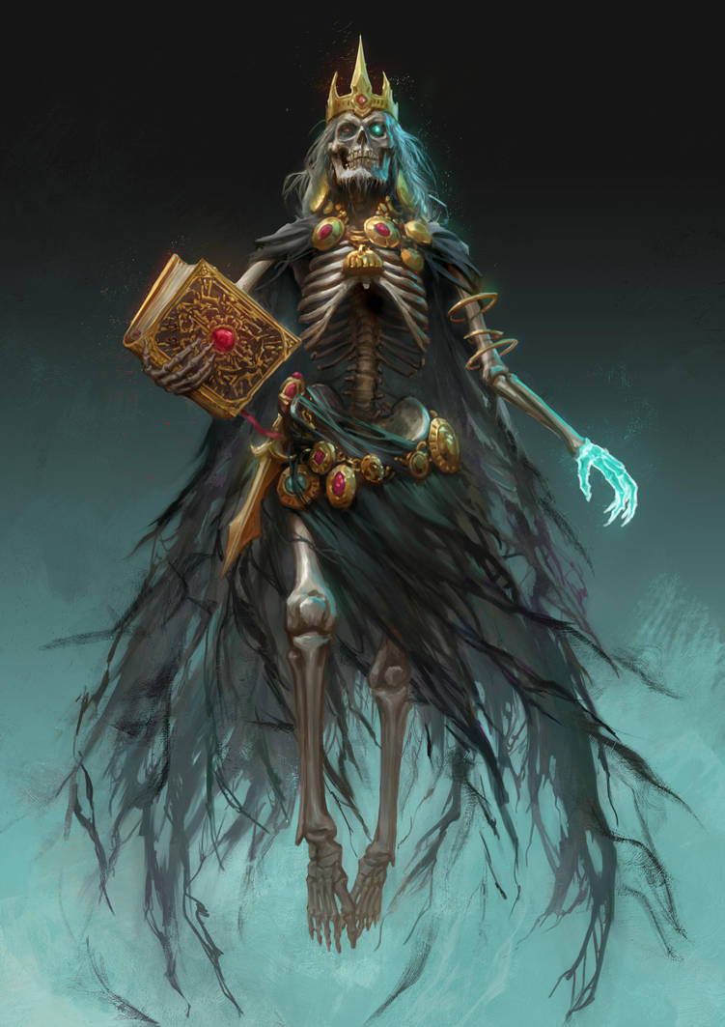
Welcome to Dragon Fodder
We will start from zero, no experience required
Participation will be rewarded
We have gifts
Targeted for Beginners, enough content that experts should have a take away or two

Slide 4
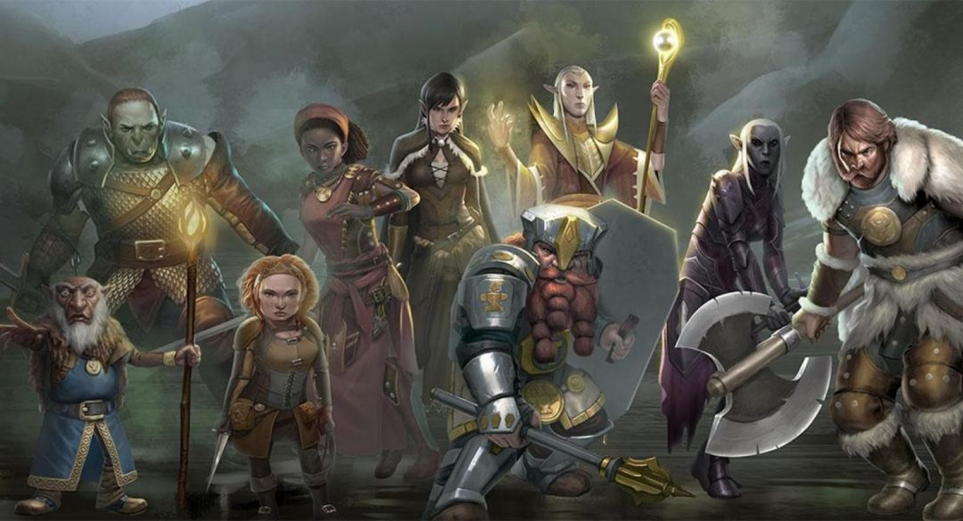
Who is Dragon Fodder?
Howard – DM – 35yrs (DM for 35yrs)
Darrel – DM – 45 yrs (DM for 5)
Jennifer – Player – 5 years of Play (4e & 5e)
Scott – Player & Pro Presenter – 3 years of Play
Chadd – Player – 1.5 years of play
In Absentia
Tom – Rogue and Paladin
Guy – Cleric and Fighter
Kate – Generally just Evil
Austin – Fighter in Seattle
Delzer – Barbarian in DFW

Slide 5

It’s PARTY play, NOT "person" play

Slide 6

Dungeons and Dragons is a game of communal storytelling

Slide 7
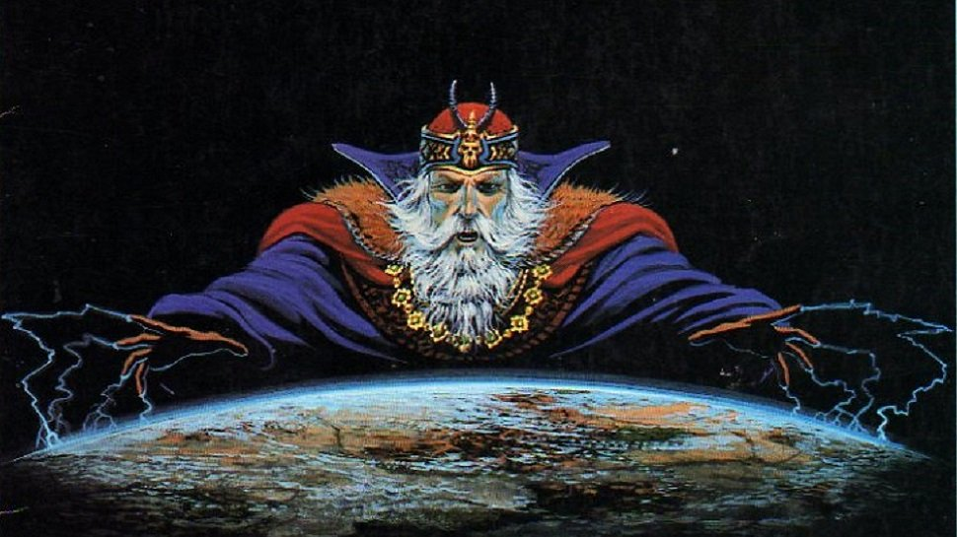
DUNGEON MASTER

Slide 8
Roles at the Table
Players – Nothing can happen without players, no matter how wonderful the scenery, they are the ones to provide action!
Dungeon Master (Game Master) – The DM is the narrator and referee.

Slide 9

Toolkit
Dice, Pencils, Dry Erase Markers
GM’s Notebook (Graph)
Campaign Worksheet
Curated Random Name List
3x5 Index Cards
Post-it Notes
Numbered Initiative Cards <or> Digital
GM Screen / Cheat Sheet(s) <or> D&D Beyond
Dry Erase Mat <or> Digital
Published Content <or> D&D Beyond
Mini’s, Maps, Terrain <or> Digital

Slide 10
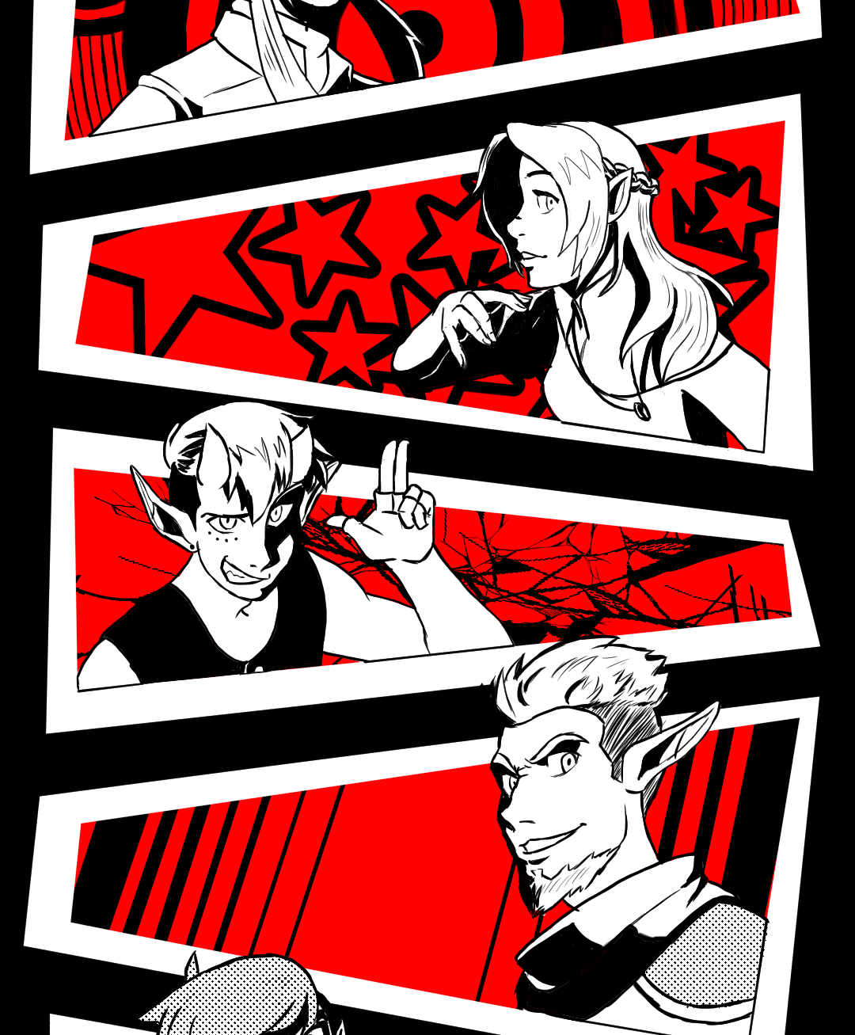
Tricks of the Trade
Milestone is the way to level
Level the whole party at once
Give the players Homework
Improvise – action, dice rolls – allow yourself and your players to be surprised
Delegate tasks to the players
Use static monster damage, or automate it as much as you can
Consider using Minions
Document your House Rules
Document your game log

Slide 11
DM’s Checklist
Review the Characters
Create a Strong Start
Outline Potential Scenes
Define Secrets and Clues
Develop Fantastic Locations
Outline Important NPCs
Choose Relevant Monsters
Select Magic Item Rewards

Slide 12

5 Min Preparation
Create a Strong Start
Define Secrets and Clues
Develop Fantastic Locations

Slide 13
Time Inbetween
Prime your brain with inspiration – from books, TV, Movies, and the internet
Remind yourself of the player’s names and motivation
Ask yourself what is happening in the world the players do not see, and what the NPC’s are doing when they are out of frame

Slide 14
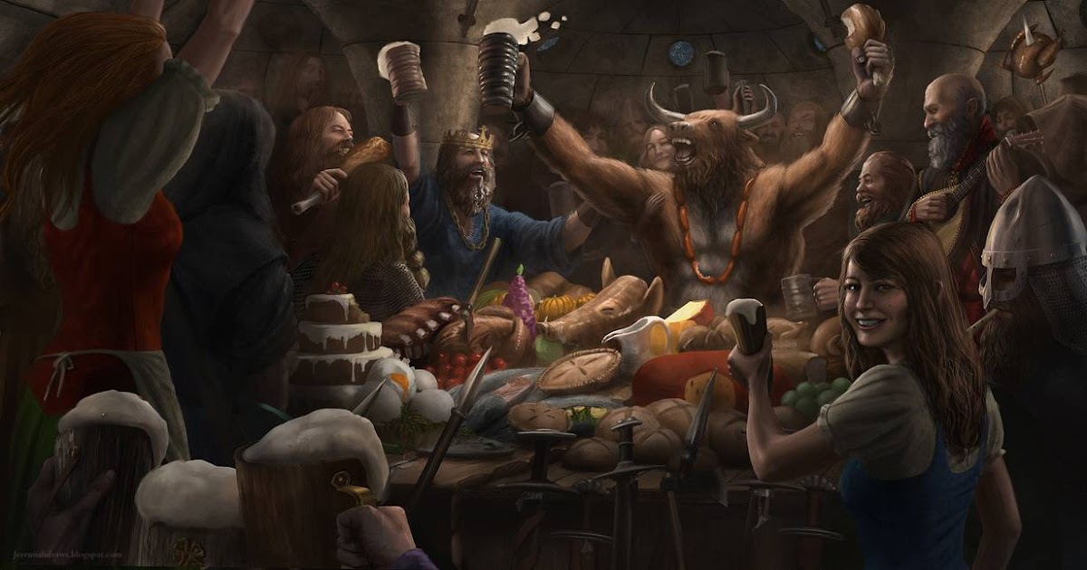
Embrace the Truths
EVERYONE wants to have Fun
Players don’t care as much as you think
Players want to see their characters do awesome things, and will talk about them in-between sessions
It is NEVER the DM vs the Players; commiserate when they fail, celebrate when they win
Be their biggest fan
Let the players break the game, then evolve it when they do

Slide 15
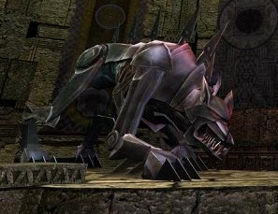
Job of the DM
Referee
Narrator
Memory

Slide 16
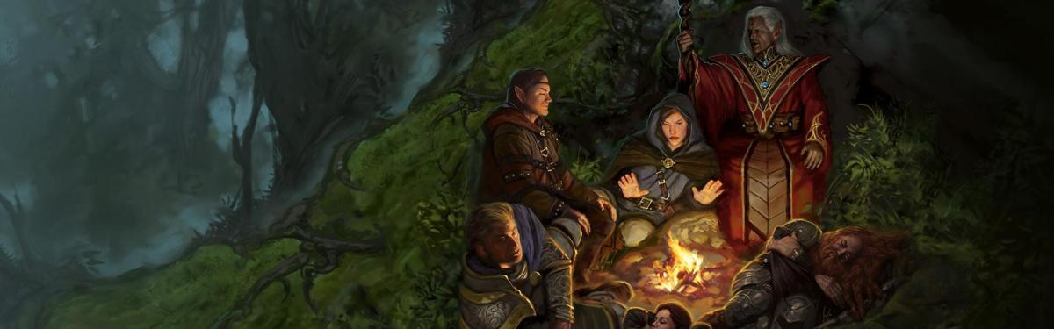
The DM has Homework
Before the Table - How should it go
At the Table - How is it going
After the Table - How did it actually go

Slide 17
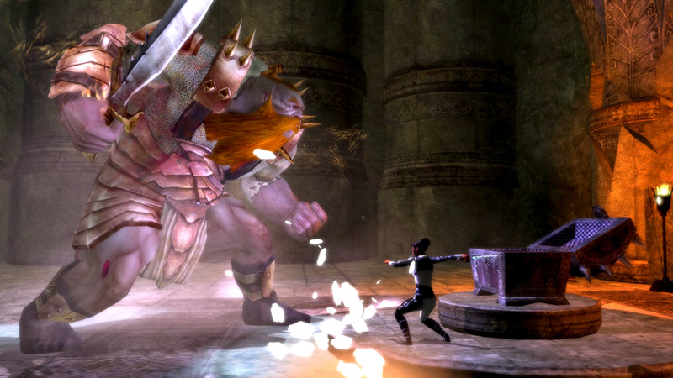
Know your game - not just the monsters - but the players too
This Photo by Unknown Author is licensed under CC BY-SA-NC

Slide 18
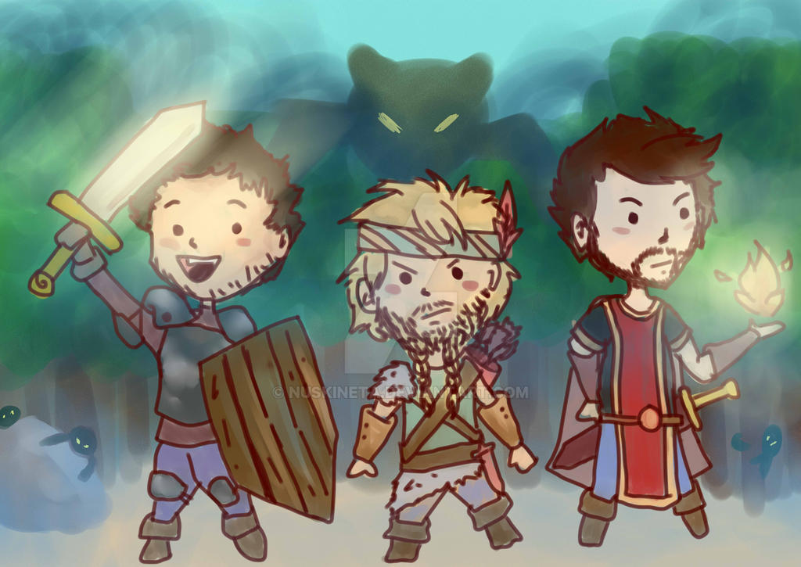
Goal: To have stories to tell about the last session.
If three sessions pass without a story, revisit your DM strategy and see how you can enable the creation of one.

Slide 19
Session Zero
Session Zero is a critical “Pre-game” session
Goals of Session Zero:
Character Creation
Align player goals
Provide background on the game world
Scheduling
Party make up
House Rules

Slide 20
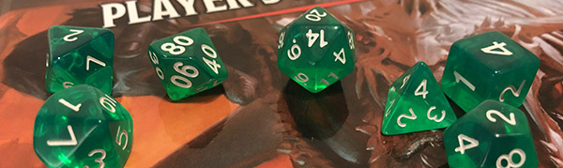
Rule #X: Steal When You Can
It is unlikely you are the first to be in this situation, the magic of Google can often provide a quick solution.
This Photo by Unknown Author is licensed under CC BY-SA-NC

Slide 21
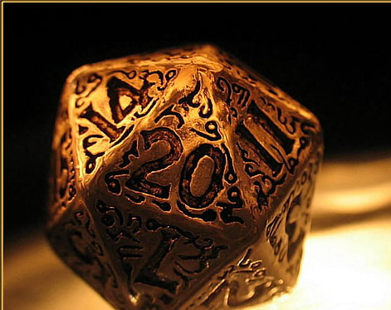
Rule #X: Perfection is the Enemy of Progress
When you are at the table, aim for “good enough” to move the game forward. Once the session is over, reflect and adjust. Use your session recap to announce the changes that your learning has provided.

Slide 22

Rule #X: The DM’s role is that of the Narrator and the Referee
It is NEVER you vs the players. You are NOT the BBEG, the King, the Dragon, etc.
Your job is to create tension that the players can overcome and celebrate with them when they do.
Help your players follow Ted Lasso’s Rule #1: Be a Goldfish

Slide 23
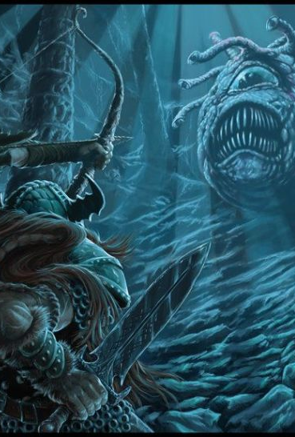
Rule #X: Let the Story Unfold at the Table
The DM brings the locations, situation, NPC’s, enemies, to the table. The players bring the motion ….. And the chaos.
Trying to play your story out won't be fun for anyone, even if you think it will be.
Let the chaos play. Chaos is where all the good stories reside.

Slide 24
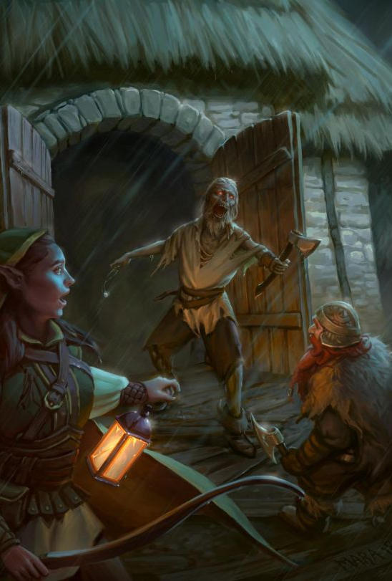
Rule #X: Set the Situation and let it run
Once you setup the situation, let the players run with it. Take pleasure and joy in what they make of the building blocks you laid at their feet.
You only really have to take a hand when they are stalled in the action.
Keep some quick things you can use to “spike” the players with and jump start some action.
This Photo by Unknown Author is licensed under CC BY

Slide 25
Rule #X: Help the Players find their Character
Characters are just numbers on a sheet until we bring them to life. This is not a skill that comes easy to everyone. The best DM’s help their players find who their characters are, what makes them tick and what gives them motivation.
Take some time to help your players move out of their comfort zone, or move away from the easy tropes.
Don’t try to do it all at once, but over time. Baby Steps

Slide 26
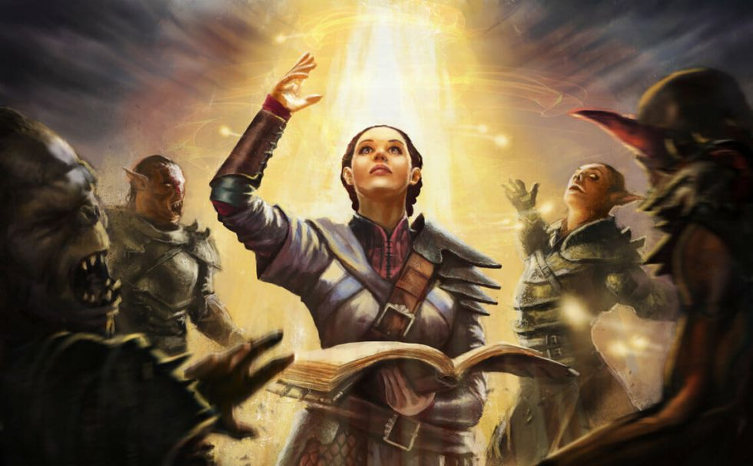
Rule #X: Rule of Cool No, but; Yes, and…
Before you look to the rulebook, look to the rule of cool.
“If it sounds cool, it is your job to make it happen – not necessarily successful”
Remember – “You can certainly try!”

Slide 27
Rule #X: The DM is always right…. Even when they are not.
Remember, you are making a game for the rest of the table, while you are always right, be willing to take time in between sessions to accept and correct your mistakes for next time.
The DM is always right to maintain pace of play.

Slide 28
Rule #X: It is okay to kill the players
Death is a part of the game, if you DM long enough it will happen. Don’t be the only person smiling when it happens (unless it is in character as the BBEG)
BE RESPECTFUL your players have likely poured some of themselves into the character. They matter to them. Give them time to mourn. Remove as much penalty as possible to roll a new character.
Give them a reason for VENGANCE!

Slide 29
Rule #X: The Enemy is Motivated – Play It
Nothing that is evil believes itself to be evil. The greatest villain's tug at some part of us that wants to agree, then pushes a little too far.
The enemies don’t want to die
The King doesn’t want to be deposed
The Lich firmly believes they are right and just
Enemies WILL run away

Slide 30
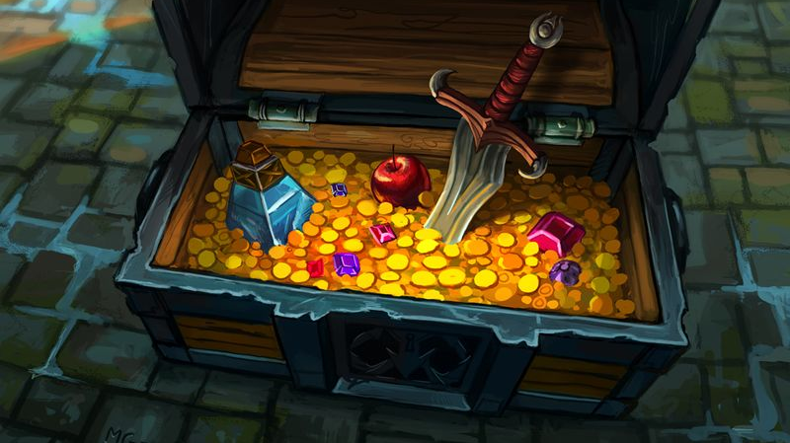
Rule #X: Hoarding
Building tension is a simple equation. Make all resources in higher demand than supply.
Force a burn of spell slots
Eat away at Potions
Add Scarcity and your player engagement skyrockets
This Photo by Unknown Author is licensed under CC BY-SA-NC

Slide 31
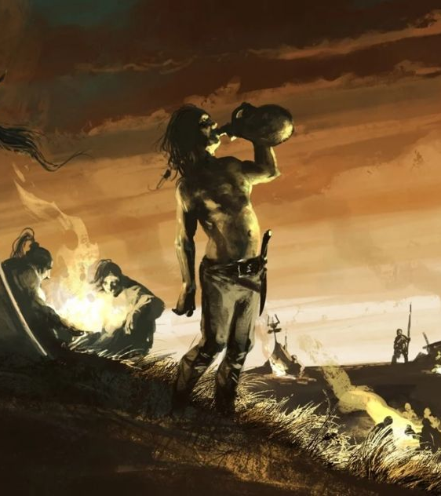
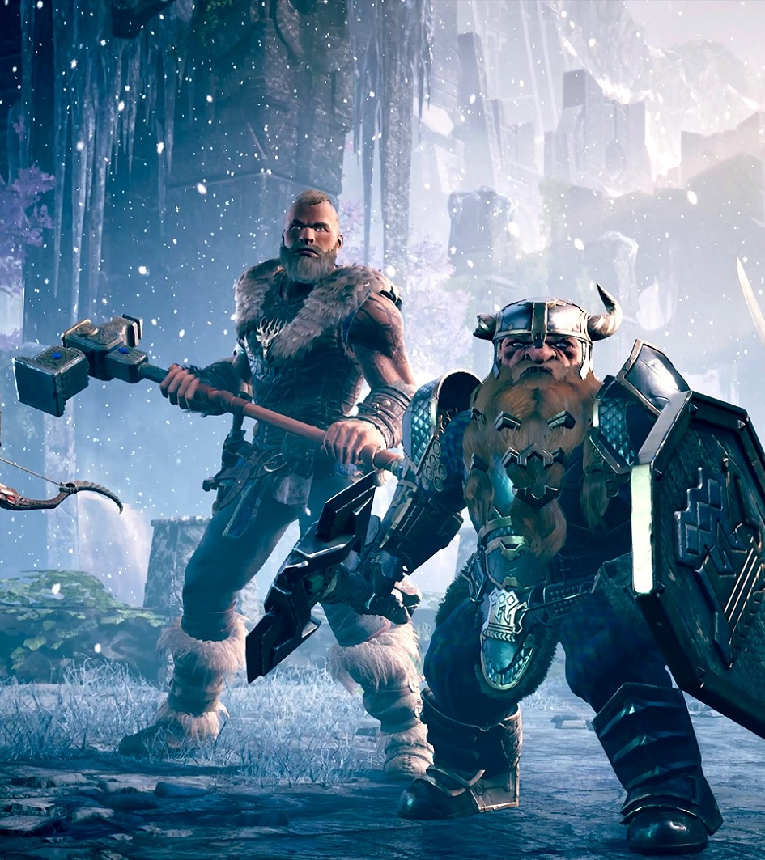
Rule #X: Allow a Grace Period
Simply give your players the time to declare their character decisions a mistake and take a mulligan.
They may not like their spell, they may not like that feat, class, whatever. Don’t put them in the position to “hate” their character, or go level after level regretting their choices.
Pay attention to those that do less damage, or frequently fail to use their resources

Slide 32
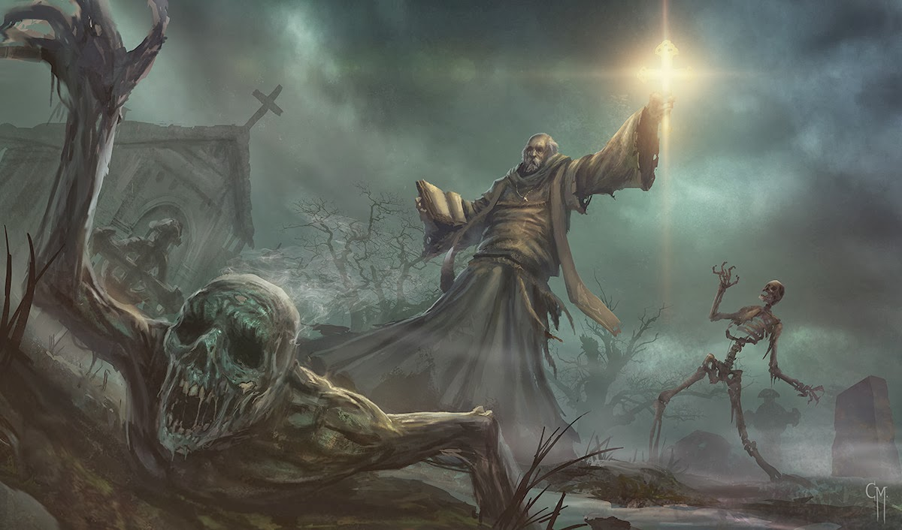
Rule #X: Use an Encounter Calculator
Balance is critical!!!! Not every encounter should be impossible or easy
Encounter Calculator, Encounter Calculator, EC
Balance…. Characters should be paced in encounters. Sometimes you want them to be winded
Figure 30 minutes per encounter
Tons of online tools:
D&D Beyond
Kobold Fight Club – Really good encounter builder https://kobold.club/fight/#/encounter-builder

Slide 33
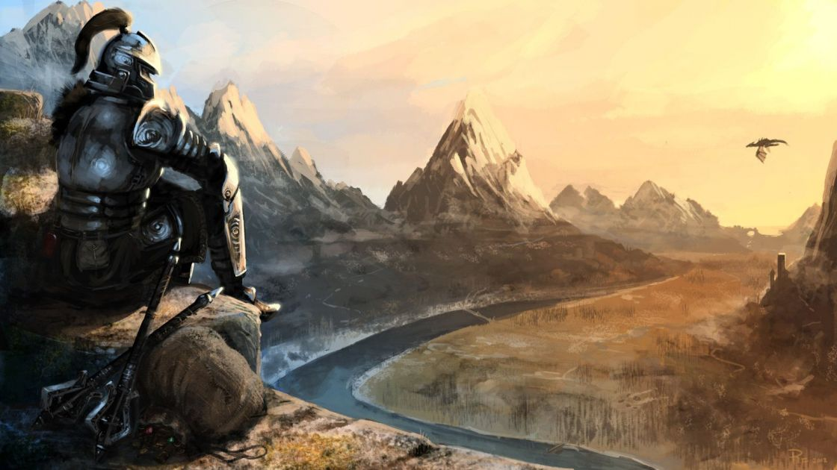
Be Consistent
(Even when Inconsistent)

Slide 34
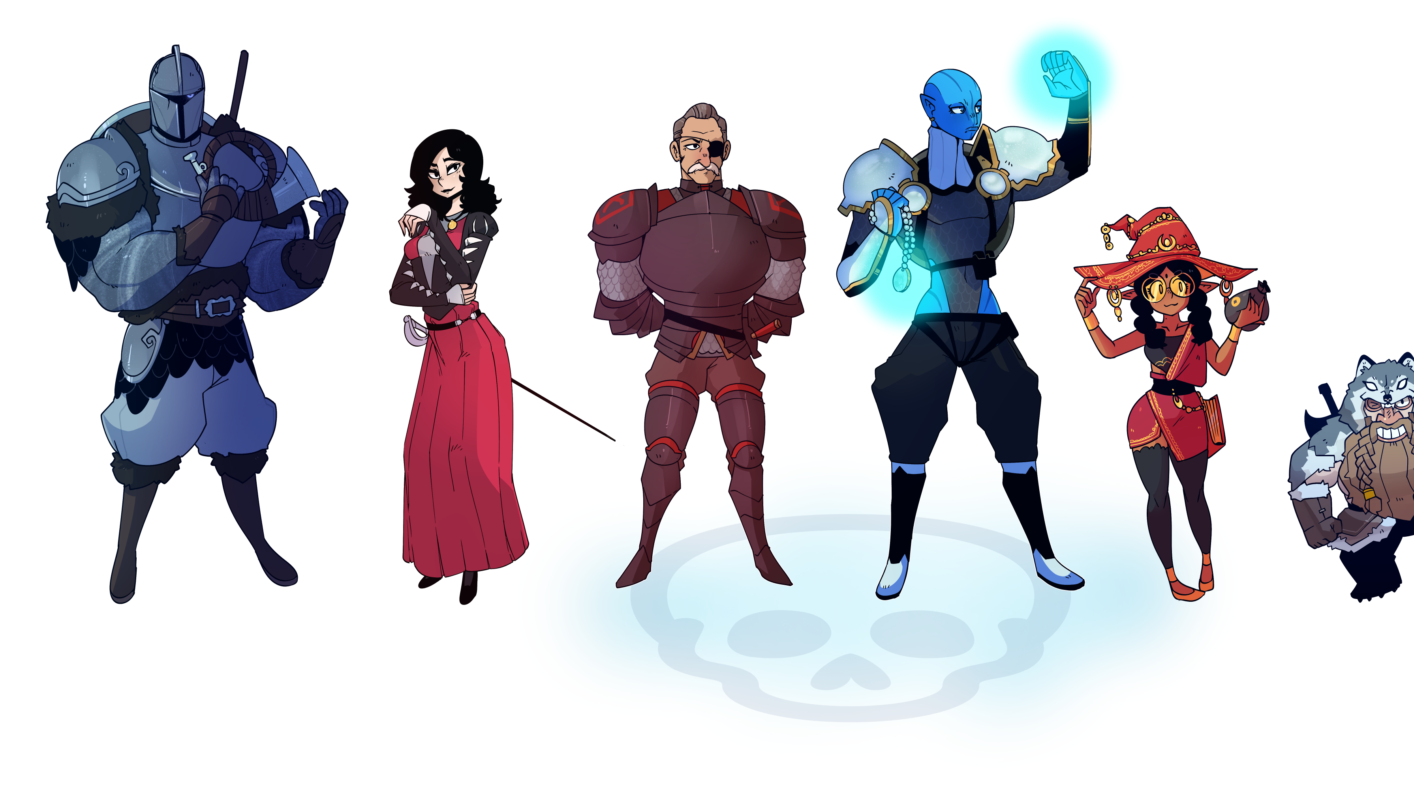
Party Size
There is an “ideal” party size – but it is dependent on the players and the DM
Needs to be large enough to be well rounded and competitive
Not so large chaos rules or players get bored waiting for something to do
Aim for 4 players
Maximum of 6 Players
Consider “quorum play” when scheduling. 1 player cannot make it? No problem, someone else can drag them for a session

Slide 35
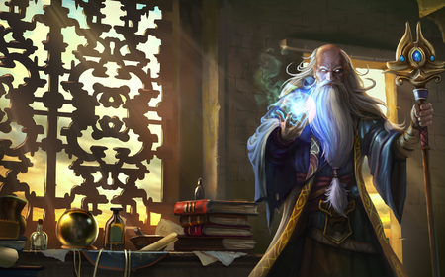
D&D Beyond is Your Best Friend
Start a Campaign
Invite your Players (using the link provided)
Share any content you have purchased (Can do rules only)
Have your players create a character in the campaign
During the campaign – keep a tab open with each player

Slide 36
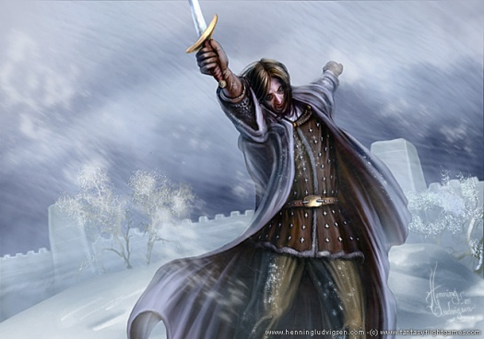
Metagaming
Metagaming (using information in the game that your player cannot or does not know), such as:
the stats of a monster you have never fought
information given to an individual player
information available to those in a room you are not in

Slide 37
Learn to Play D&D
Friday
Learn to be a Dungeon Master
Saturday
Worldbuilding for D&D
Saturday
Running the Game and Campaign
Sunday
Using Online Tools to Play D&D
Sunday
7:30pm
11:30 am
1:30 pm
12:30 pm
2:30 pm
https://www.facebook.com/dragonfodderdm
Notes:
https://github.com/majornerd/dragonfodder

